Slide 1
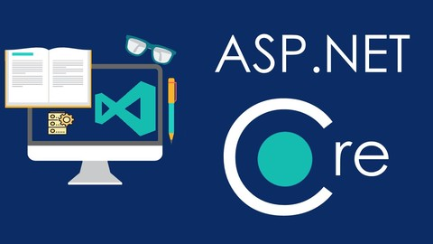
Introduction to ASP.NET Core (MVC)
ASP.NET Core, Controllers & Actions, Routing, Razor, Identity
SoftUni Team
Technical Trainers
Software University
https://softuni.bg

Slide 2
Table of Contents
ASP.NET Core Overview
ASP.NET Core MVC Overview
Creating our first ASP.NET Core Projects
Controllers & Actions
Routing
Static Files
Razor View Engine
ASP.NET Core Identity System

Slide 3
Have a Question?
sli.do #csharp-web

Slide 4
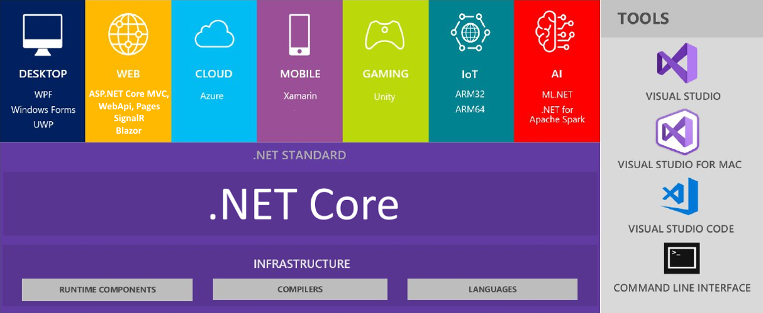
.NET Core: Bird's Eye View

Slide 5
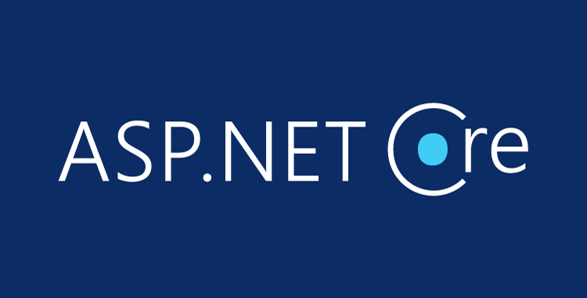
ASP.NET Core Overview

Slide 6
ASP.NET Core Overview
ASP.NET Core is a cross-platform, open-source web framework
You can build web applications and services, IoT apps, mobile backends and any web-based solution with ASP.NET Core
It can be deployed to the cloud (e.g. Azure)
Great documentation: https://docs.microsoft.com/en-us/aspnet
ASP.NET Core provides:
Integration of modern client-side frameworks (Angular, Blazor, etc.) and development workflows (MVC, WebAPI, Razor Pages, SignalR)
ASP.NET Core applications run both on .NET Core and .NET Framework

Slide 7
ASP.NET Core Main Features
A unified framework for building web UI and web APIs, architected for testability
Ability to develop and run on Windows, macOS, and Linux
Ability to host on IIS, Nginx, Apache, Docker, or self-host in your own process
Built-in dependency injection
A lightweight, high-performance, and modular HTTP request pipeline (middlewares)
Razor Pages is a page-based programming model that makes building web UI easier
Blazor lets you use C# in the browser and share server-side and client-side app logic
Razor markup provides syntax for Razor Pages, MVC views and Tag Helpers
Cloud-ready, environment-based configuration system
Side-by-side app versioning
Tooling that simplifies modern web development (Visual Studio, VS Code, CLI)

Slide 8
ASP.NET vs ASP.NET Core
ASP.NET is a mature framework (v1.0 released January 2002)
Provides the services needed to build enterprise-class, server-based web applications on Windows
ASP.NET MVC works only on Windows and only in IIS
Latest version: 5.2.5
ASP.NET Core is a relatively new open-source framework (v1.0 released June 2016)
Cross-platform framework
Suitable for building modern, cloud-based web applications on Windows, macOS, or Linux
Latest version: 6.0

Slide 9
ASP.NET vs ASP.NET Core (2)
ASP.NET MVC
One version per machine
System.Web.dll
Everything is included by default
HTTP Modules, HTTP Handlers, Global.asax
MVC + Web API + Web Pages
Child Actions (Html.Render)
Web.config
ASP.NET Core
Kestrel, Windows, Mac, Linux
Multiple versions per machine
Everything is Nuget packages
Middlewares. All-in-one. Faster.
JSON and environment variables
View Components, Tag Helpers
Build-in DI, logging, services, file providers, WebSockets

Slide 10
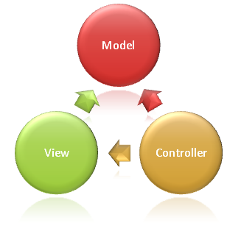
ASP.NET Core MVC Overview

Slide 11
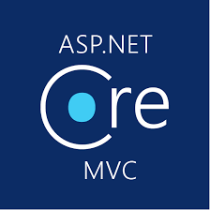
ASP.NET Core MVC (1)
ASP.NET Core MVC provides features to build web APIs and web apps
Uses the Model-View-Controller (MVC) design pattern
Lightweight, Open Source, Testable, Good Tooling
Razor markup for Razor Pages and MVC views
RESTful services with ASP.NET Core Web API
Built-in support for multiple data formats, content negotiation and CORS
Achieve high-quality architecture design, optimizing developer work
Convention over Configuration
Model binding automatically maps data from HTTP requests
Model validation with client-side and server-side validation

Slide 12


ASP.NET Core MVC (2)
Along with those ASP.NET Core MVC provides features like:
Routing
Dependency injection
Strongly-typed views with the Razor view engine
Tag Helpers enable server-side code in HTML elements
Partial views and view components
Filters, Areas, Middlewares
Built-in security features
Identity with users, roles and external providers
And many more…

Slide 13
The MVC Pattern for Web
HTTP Request
ASP.NET Core (routing + middlewares)
/Some/Page/
Delegate request
User
Controller
(action)
HTTP Response
CRUD model
Select view & pass data
Razor View
(render UI)
Model (data)
Use model data

Slide 14

Creating Your First ASP.NET Core Projects
Hello, ASP.NET Core

Slide 15

Controllers and Actions

Slide 16
Controllers
The core component of the MVC pattern
All the controllers should be available in a folder name Controllers
Controller naming standard should be {name}Controller (convention)
Every controller should inherit the Controller class
Access to Request, Response, HttpContext, RouteData, TempData, ModelState, User, ViewBag / ViewData, etc.
Routes select Controllers in every request
All requests are mapped to a specific action

Slide 17
Actions
Actions are the ultimate Request destination
Public controller methods
Non-static
No return value restrictions
Actions typically return an IActionResult
public IActionResult Details(int id)
{
var viewModel = this.dataService.GetById(id).To<DetailsViewModel>();
return this.View(viewModel);
}

Slide 18
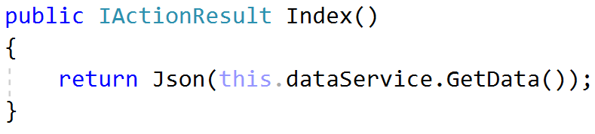
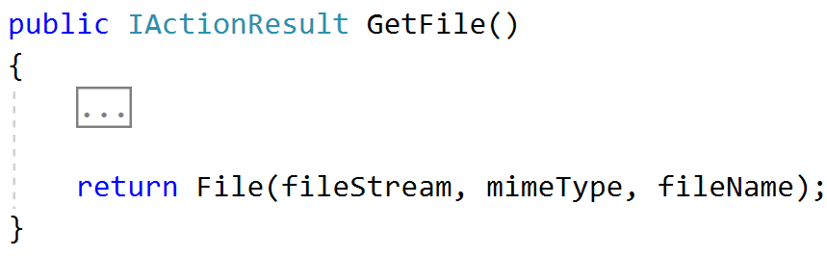
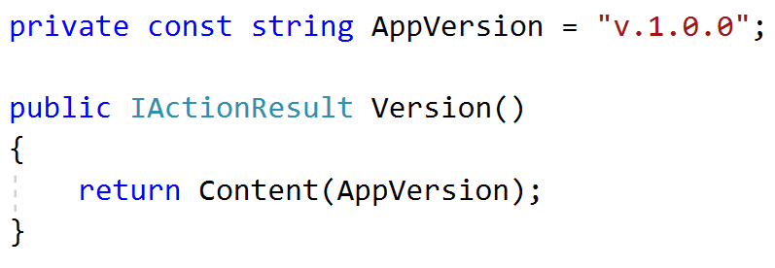
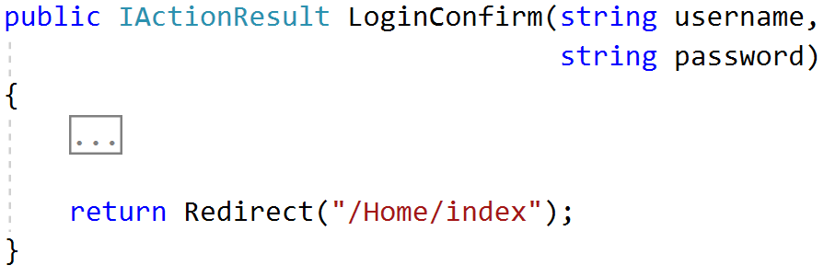
Action Results (1)
Controller action response to a browser request
Represent various HTTP Status Codes
Inherit from the base ActionResult class

Slide 19
Action Results (2)
Name | Framework Behavior | Helping Method
StatusCodeResult | Returns an HTTP Response Result with given Status | StatusCode() / Ok() BadRequest() / NotFound()
JsonResult | Returns data in JSON format | Json()
RedirectResult | Redirects the client to a new URL | Redirect() / RedirectPermanent()
RedirectToRouteResult | Redirect to another action, or another controller’s action | RedirectToRoute() / RedirectToAction()
ViewResult PartialViewResult | Response is the responsibility of a view engine | View() / PartialView()
ContentResult | Returns a string literal | Content()
EmptyResult | No response, no content-type header
FileContentResult FilePathResult FileStreamResult | Return the contents of a file | File() / PhysicalFile()

Slide 20
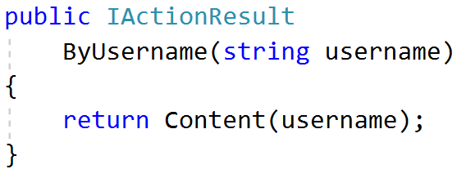
Action Parameters
ASP.NET Core maps the data from the HTTP request to action parameters in few ways:
Routing engine can pass parameters to actions
http://localhost/Users/John
Routing pattern: Users/{username}
URL query string can contains parameters
/Users/ByUsername?username=JohnSnow
HTTP post data can also contain parameters

Slide 21
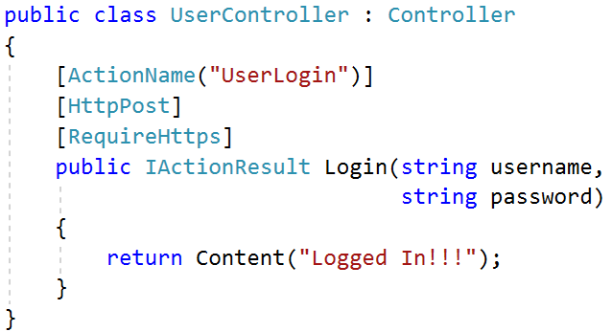
Action Selectors
ActionName(string name)
AcceptVerbs
HttpPost
HttpGet
HttpDelete
HttpOptions
…
NonAction
RequireHttps
etc.

Slide 22
ASP.NET Core MVC Routing

Slide 23
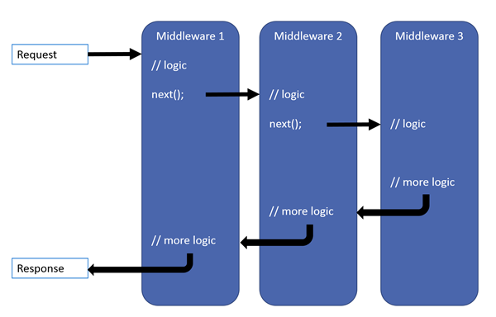

ASP.NET Core MVC Routing
ASP.NET Core MVC uses a middleware for Routing on client requests.
Routes describe how request URL paths should be mapped to Controller Actions.
There are 2 types of Action routing
Conventional
Attribute

Slide 24
Conventional Routing
Called Conventional because it establishes a convention for URL paths.
public void Configure(IApplicationBuilder app, IHostingEnvironment env)
{
app.UseEndPoints(routes =>
{
routes.MapControllerRoute(
name: "default",
template: "{controller=Home}/{action=Index}/{id?}");
});
}
Will match a route like "/Cats/Show/1"
Will extract the route values:
{ controller = "Cats",
action = "Show",
id = "1" }

Slide 25
Route Constraints
Route Constraints are rules on the URL segments
All the constraints are regular expression compatible with the Regex class
Defined as one of the routes.MapRoute(…) parameters
routes.MapRoute(
name: "blog",
template: "{year}/{month}/{day}",
defaults: new { controller = "Blog", action = "ByDate" },
constraints: new { year = @"\d{4}", month = @"\d{1,2}", day = @"\d{1,2}", });

Slide 26
Attribute Routing
Attribute routing uses a set of attributes to map actions directly to route templates.
public class HomeController : Controller
{
[Route("/")]
public IActionResult Index()
{
return View();
}
}

Slide 27
Attribute Routing
Attribute routing can also directly define the Request Method.
public class HomeController : Controller
{
//...
[HttpGet("/")]
public IActionResult Index()
{
return View();
}
}
public class UsersController : Controller
{
//...
[HttpPost("Login")]
public IActionResult Login()
{
return View();
}
}
Http{action} attributes are quite often used in REST APIs.

Slide 28
Attribute Routing
Attribute routing allows you to create multiple routes for a single action.
It also allows you to combine a Route for a Controller and an Action Route.
[Route("Home")]
public class HomeController : Controller
{
//...
[Route("/")] // Does not combine, Route – /
[Route("Index")] // Route - /Home/Index
[Route("")] // Route - /Home
public IActionResult Index()
{
return View();
}
}
public class HomeController : Controller
{
//...
[Route("/")]
[Route("Index")]
public IActionResult Index()
{
return View();
}
}

Slide 29
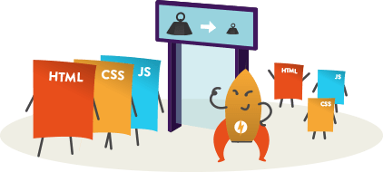
Static File Routing

Slide 30
Static Files (1)
Static files are a necessity for a web application to work.
Files such as HTML, CSS, JS, and different Assets can be served directly to Clients with ASP.NET Core
public void Configure(IApplicationBuilder app, IHostingEnvironment env)
{
app.UseStaticFiles();
}
This will tell the ASP.NET Core App to serve the static files in the wwwroot directory.

Slide 31
Static Files (2)
Can be modified to serve other folders.
public void Configure(IApplicationBuilder app, IHostingEnvironment env)
{
app.UseStaticFiles(); // For the wwwroot folder
app.UseStaticFiles(new StaticFileOptions()
{
FileProvider = new PhysicalFileProvider(
Path.Combine(Directory.GetCurrentDirectory(), "OtherFiles")),
RequestPath = new PathString("/files")
});
}
Folder in Project
This will serve "style.css" file upon request "http://{app}/files/style.css" from "OtherFiles" instead of "wwwroot"

Slide 32

Razor View Engine

Slide 33
Views
HTML templates of the application
A lot of view engines available
View engines execute code and provide HTML
Provide a lot of helpers to easily generate HTML
The most popular is Razor View Engine
We can pass data to views through:
ViewBag, ViewData and Model (strongly-typed views)

Slide 34
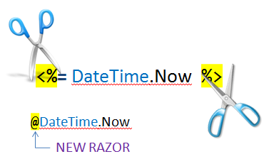
Razor
Template markup syntax
Simple-syntax view engine
Based on the C# programming language
Enables the programmer to use an HTML construction workflow
Code-focused templating approach, with minimal transition between HTML and code
Razor syntax starts code blocks with a @ character and does not require explicit closing of the code-block

Slide 35

Passing Data to a View
With ViewBag (dynamic type):
Action: ViewBag.Message = "Hello World!";
View: @ViewBag.Message
With ViewData (dictionary)
Action: ViewData["message"] = "Hello World!";
View: @ViewData["message"]
With Strongly-typed views:
Action: return View(model);
View: @model ModelDataType;

Slide 36

ASP.NET Core Identity System
Overview

Slide 37

ASP.NET Identity
The ASP.NET Core Identity system
Authentication and authorization system for ASP.NET Core Web apps
Supports ASP.NET Core MVC, Web API, SignalR, Blazor
Handles Users, User Profiles, Login / Logout, Roles, etc.
Keeps the user accounts in local DB or in external data store
Included via middleware:
app.UseAuthentication();

Slide 38

Summary
ASP.NET Core is a great platform for developing Web apps
Well-designed, Easily extensible, Highly testable
Has a large (and growing) community
Built from the ground up
But makes development easier for legacy ASP.NET developers
…
…
…

Slide 39
Questions?
Notes:
39

Slide 40













SoftUni Diamond Partners

Slide 41


Educational Partners

Slide 42
Trainings @ Software University (SoftUni)
Software University – High-Quality Education, Profession and Job for Software Developers
softuni.bg, softuni.org
Software University Foundation
softuni.foundation
Software University @ Facebook
facebook.com/SoftwareUniversity
Software University Forums
forum.softuni.bg
Notes:
42

Slide 43

License
This course (slides, examples, demos, exercises, homework, documents, videos and other assets) is copyrighted content
Unauthorized copy, reproduction or use is illegal
© SoftUni – https://softuni.org
© Software University – https://softuni.bg
Notes:
43

